Slide 1
Progress Report
Team 12

Slide 2
Goals
Given a body of text, we wish to perform the following two tasks:
Knowledge Abstraction
Generate a knowledge graph from text
Identify and present most important sets of information
Summary Generation
Generate a summary for the given text
Explore extractive vs. generative approaches for summarization

Slide 3
Knowledge Abstraction
Generate knowledge graph
Triplets
Perform clustering to bunch similar entities together
Evaluate importance of each entity within a cluster
Macro-level via graph structure
Micro-level by analyzing each individual entity
Importance metrics:
Between-ness Centrality
Eigen Centrality
Extract important entities from each cluster
These form candidate entities for summarization
Embedding scores for each entity created using:
word2vec
sense2vec

Slide 4
Text Summarization
We have looked at text summarization as the core task. TextRank is one of the more popular methods which applies PageRank to text to identify key sentences. LexRank works off degree centrality instead. Note that these are extractive summarizers.
We would like to implement a generative summarizer that can compare against these models. If we are unable to proceed in this direction, we will default to using these baseline models by implementing them and looking at improving that implementation.
TextRank reference: https://cran.r-project.org/web/packages/textrank/vignettes/textrank.html
LexRank reference: https://www.cs.cmu.edu/afs/cs/project/jair/pub/volume22/erkan04a-html/erkan04a.html

Slide 5
Text Summarization
Proposed Experiment
Use original BERT model, experiment with fine tuning on the wikipedia data set
Experiment with various ways to improve the performance of the model, which can include but not limited to:
Data augmentation
Model architecture, including new input and output layers, or incorporate other models into the base model
Feature engineering

Slide 6
Text Summarization
Proposed Experiment
Setup WikiGraphs model using GNN to convert the knowledge graph representation into a summary
Utilise the generated knowledge graphs from the wikipedia text as inputs to the model to generate summary
WikiGraphs reference: https://arxiv.org/pdf/2107.09556.pdf

Slide 7
Progress
Literature Review
Literature review of existing models for knowledge graphs, summarization and question answering. Accomplished by everyone in the group by splitting the topics for review for everyone in the team.
Experiment: Text Summarization
Implemented TextRank to see its effectiveness.
Implemented a simple complexity scorer using syllable counter
Experiment: Knowledge Graphs
Implemented knowledge graph generation using Co-ref resolution, NER and tweaked tokenization. Triplets generated dependency graph and visualized via interactive graphs using pyVis.
Overall
Our current progress is satisfactory according to the schedule.
Potential problems include the lack of computational power, as training BERT or LLMs can be computationally expensive.

Slide 8
Academic Paper Review
Text Summarization Techniques: A Brief Survey (arXiv:1707.02268v3)
What Have We Achieved on Text Summarization? (arXiv:2010.04529v1)

Slide 9
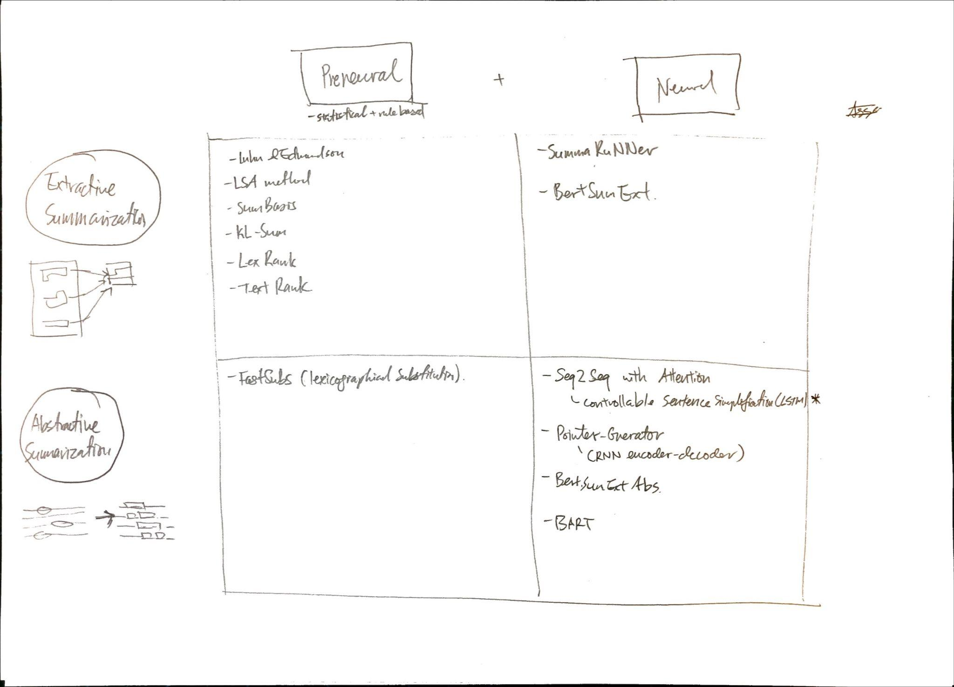
Text Summarization Models
“What Have We Achieved” paper does great job of setting up a framework. We talked about “simplification” and “shortening”. They have called it Extractive and Abstractive and laid out various approaches.
The framework has been extended with content from “A Brief Survey”

Slide 10
Overview of Non-Neural Text Summarization Methods
Models that could be a fall-back if neural approaches do not work
Luhn’s and Edmundson’s approaches:
Summary: Luhn’s approach is a heuristic-based method that involves assigning scores to sentences based on their frequency of occurrence and position within the text. Edmundson’s approach is an extension of Luhn’s method that also takes into account the contextual significance of sentences.
Pros:
Simple and straightforward
Can be easily implemented
Does not require a lot of computational resources
Cons:
Does not always produce high-quality summaries
Does not account for semantic relationships between sentences
Relies heavily on heuristics, which may not always produce accurate results
LSA method:
Summary: Latent Semantic Analysis (LSA) is a method that uses singular value decomposition (SVD) to identify latent topics in a document. The summarization process involves representing the document as a term-document matrix, reducing the dimensionality of the matrix using SVD, and then selecting the most important sentences based on their relevance to the identified topics.
Pros:
Can handle synonymy and polysemy effectively
Can capture relationships between words and phrases
Can be applied to a wide range of text types and domains
Cons:
Requires a large amount of computational resources
Can produce summaries that are dense and difficult to understand
Does not always capture the most important information in the document
SumBasic:
Summary: SumBasic is a greedy method for text summarization that selects sentences based on their importance scores. The scores are generated by combining the position of sentences, frequency of words, and term frequency-inverse document frequency (TF-IDF) values.
Pros:
Simple and easy to implement
Can produce good quality summaries for certain types of documents
Does not require a lot of computational resources
Cons:
Relies heavily on heuristics, which may not always produce accurate results
Does not take into account relationships between sentences or the overall structure of the document
Can produce repetitive or redundant summaries
KL-Sum:
Summary: KL-Sum is a graph-based method for text summarization that uses the Kullback-Leibler (KL) divergence to measure the similarity between sentences. The summarization process involves constructing a sentence graph, where nodes represent sentences and edges represent the similarity between sentences, and then selecting the most important sentences based on their centrality in the graph.
Pros:
Can handle large and complex documents effectively
Can produce coherent and concise summaries
Can take into account relationships between sentences
Cons:
Can be computationally expensive
Can produce summaries that are dense and difficult to understand
May not always produce high-quality summaries
LexRank:
Summary: LexRank is a graph-based method for text summarization that uses eigenvector centrality to measure the importance of sentences. The summarization process involves constructing a sentence graph, where nodes represent sentences and edges represent the similarity between sentences, and then selecting the most important sentences based on their centrality in the graph.
Pros:
Can handle large and complex documents effectively
Can produce coherent and concise summaries
Can take into account relationships between sentences
Cons:
Can be computationally expensive
Can produce summaries that are dense and difficult to understand
May not always produce high-quality summaries
TextRank:
Summary: TextRank is an unsupervised algorithm that utilizes graph-based ranking to identify the most important sentences in a document and summarize them. The algorithm works by creating a graph of words and sentences, with edges connecting similar words, and then ranking the sentences based on the importance of the words they contain.
Pros:
TextRank is a simple and intuitive algorithm that is easy to implement.
It doesn’t require any labeled data, making it a good choice for text summarization tasks.
TextRank is capable of handling large documents, as it can be easily scaled.
Cons:
TextRank can produce summaries that are too short or too long.
The quality of the summaries produced by TextRank may be influenced by the quality of the text pre-processing.
TextRank can be time-consuming, as it requires multiple iterations to arrive at the final summary.

Slide 11
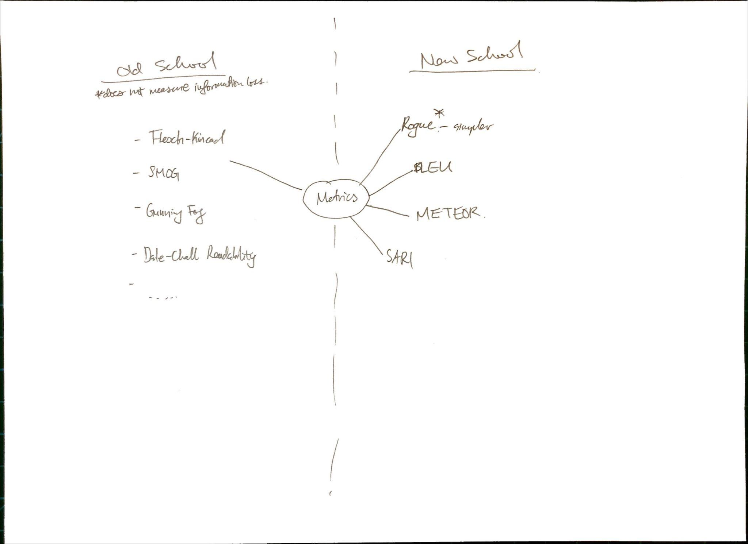
Text Summarization Metrics
Various industry metrics.
Old school metrics generally look for syntactic structure and ignore semantics.
New school is a bit opaque. SARI would be best for meaning preservation, but rogue is good enough (see paper: optimisingStatLearning)
New School
ROUGE measures the similarity between a machine-generated summary and a reference summary. It calculates the overlap between the two summaries in terms of n-grams and provides several different metrics, such as ROUGE-N, ROUGE-L, and ROUGE-W, which evaluate different aspects of the summaries. ROUGE is simple to implement, easy to understand, and provides a clear evaluation of the quality of the machine-generated summaries.
SARI, on the other hand, is a more sophisticated metric that evaluates the content preservation and fluency of the machine-generated summary. It compares the machine-generated summary to the input text and the reference summary, and calculates the preservation of content, fluency, and grammaticality. Unlike ROUGE, SARI takes into account the relevance of the machine-generated summary to the input text, and it provides a more comprehensive evaluation of the quality of the summary.
In terms of the differences, ROUGE provides a simple and straightforward evaluation of the similarity between the machine-generated summary and the reference summary, while SARI provides a more comprehensive evaluation of the content preservation, fluency, and grammaticality of the machine-generated summary. ROUGE is easier to implement and understand, while SARI provides a more sophisticated evaluation of the quality of the summary.
Old School
Flesch Reading Ease: A score that measures the readability of a text based on sentence length and the number of syllables per word.
SMOG (Simple Measure of Gobbledygook): A measure of the readability of a text based on the number of polysyllabic words and sentence length.
Gunning Fog Index: A measure of the readability of a text based on sentence length, the number of words with more than two syllables, and the complexity of the words used.
Coleman-Liau Index: A measure of readability that takes into account characters per word, sentences per 100 words, and the number of words with more than 3 syllables.
Automated Readability Index (ARI): A measure of readability that takes into account the average length of sentences and words in a text.
Dale-Chall Readability Formula: A measure of readability that takes into account the difficulty of words in a text and the length of sentences.
Linsear Write Formula: A measure of readability that takes into account the average number of syllables per word and the average sentence length.

Slide 12
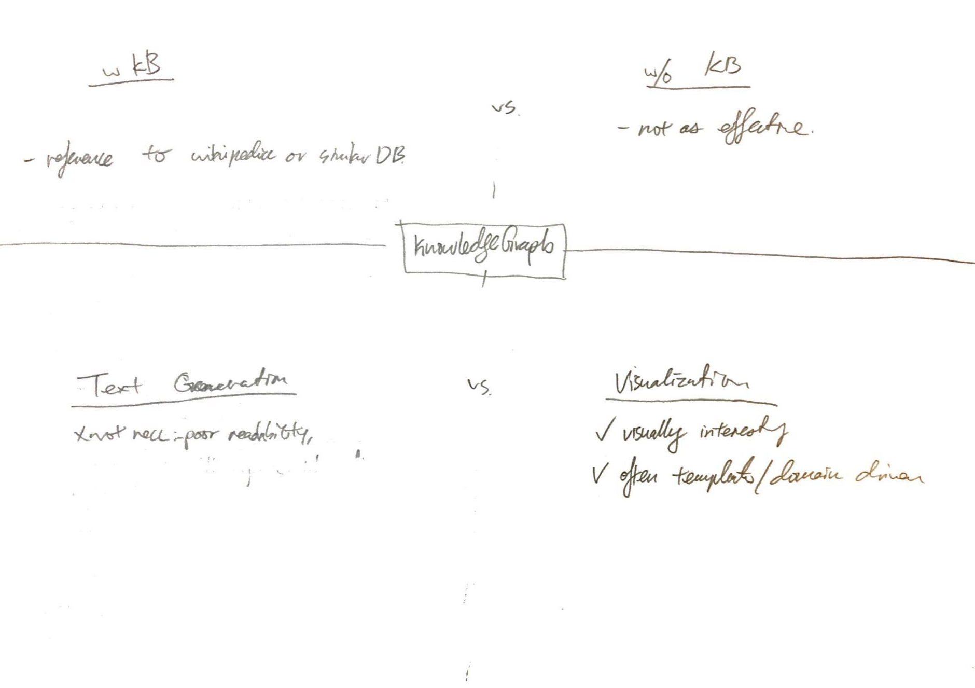

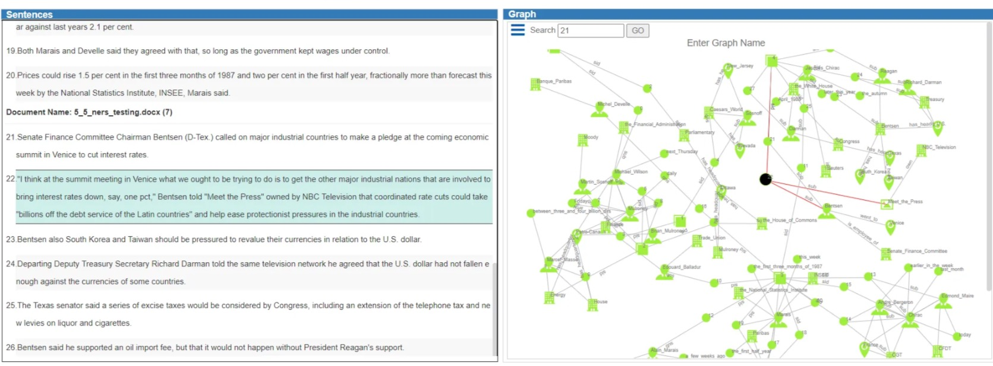
Knowledge Graph Notes
Generally, 2 types: 1x uses a reference Knowledge Base (e.g. wikipedia), 1x builds direct from doc
Text Translation always reads goofy. One paper resorted to “templated” outputs. My sense is if we want to succeed here, topical specialization will help.
Viz… can be nice when filtered or visually designed. If not, it looks really overwhelming and won’t help with learning.

Slide 13
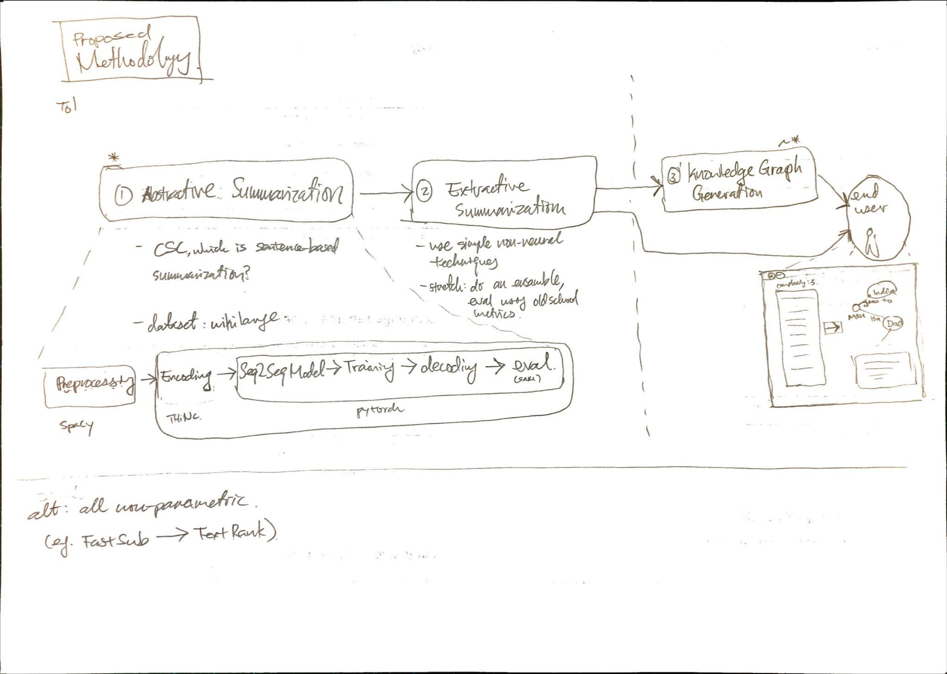
Proposed Methodology
For discussion. Below is a stab at how we can approach the problem in modular parts.
Abstractive: to use neural. Extractive, to use non-neural. Knowledge Graph as a supplement to the summarized text.

Slide 14
Appendix: TextRank

Slide 15
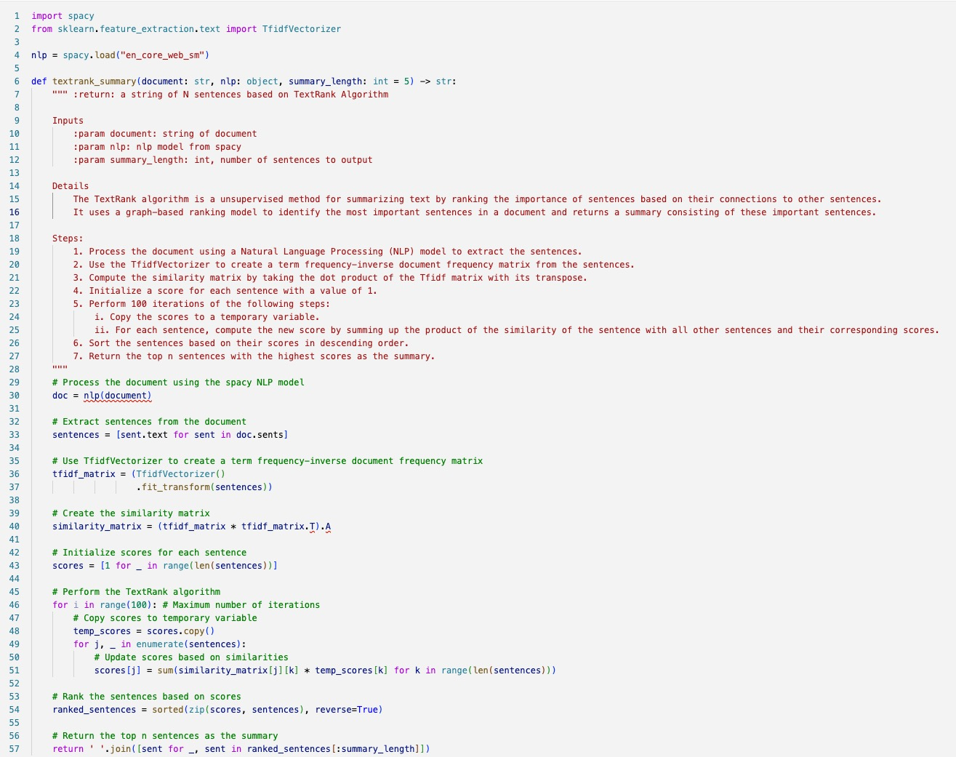
TextRank
Implemented a simple TextRank function using SpaCy and sklearn packages.
Example of Wikipedia article on “Spicegirls”, summarized to 2 extracted sentences:
“They reunited for two concert tours, the Return of the Spice Girls (2007–2008) with Halliwell, and Spice World – 2019 tour, both of which won the Billboard Live Music Award for highest-grossing engagements, making the Spice Girls the top touring all-female group from 1998 to 2020.”
“In 1997, the Spice Girls made their live debut concert tour and starred in a film, Spice World, to commercial success.”
… not too bad!

Slide 16
Learnings
The text summarization algorithm appears to perform better for lifestyle documents than it does for scientific or financial documents. This might be because there is a bias toward big words in scientific and financial literature which can be considered "essential" to summarization.
Co-Reference Resolution is important! Having articles like “they”, without context, can be misleading
Notebook link: https://drive.google.com/drive/folders/1-2SzV0tGIrhr-eITv_SDaPCzWa7iFvcp?usp=sharing

Slide 17
Appendix: Co-Ref Res

Slide 18
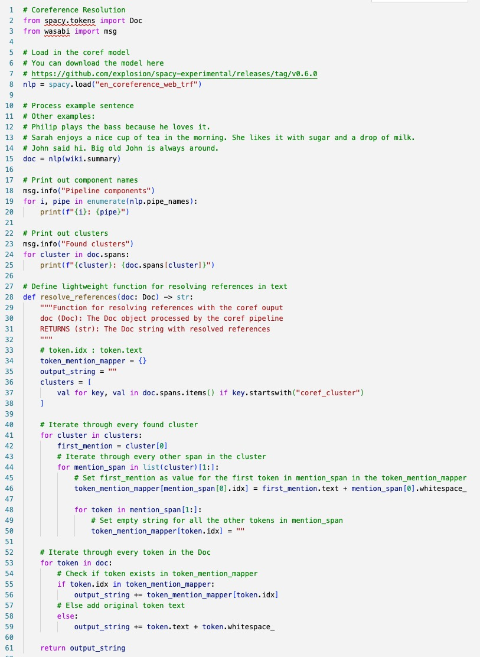
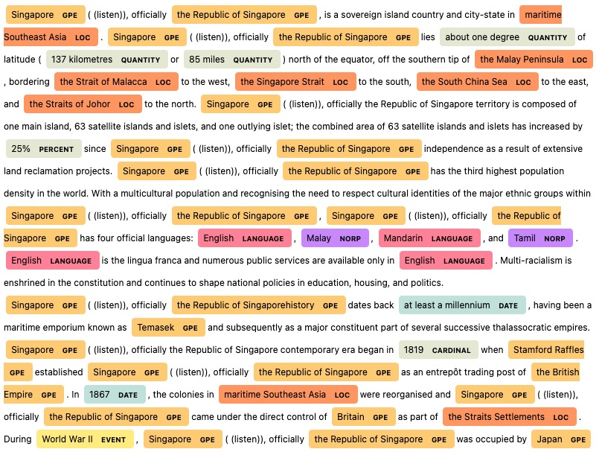
Co-Ref Res
Used an experimental branch of SpaCy to do co-reference resolution.
Example: output based on “Singapore” wikipedia article. Note: no more “it”, “they”, etc.

Slide 19
Learnings
Pipelines - Technically, the co-res ref implementation in SpaCY uses the trf pipeline. This is incompatible with the standard pipeline. Hence, two separate pipelines will need to be built, with co-ref res passing a processed doc to the normal pipeline after.
Notebook link: https://drive.google.com/file/d/1kO0Q7DaFkBMhIym5eNZzV4crWLOVUyaf/view?usp=sharing

Slide 20
Appendix: Triples & Knowledge Graphs

Slide 21
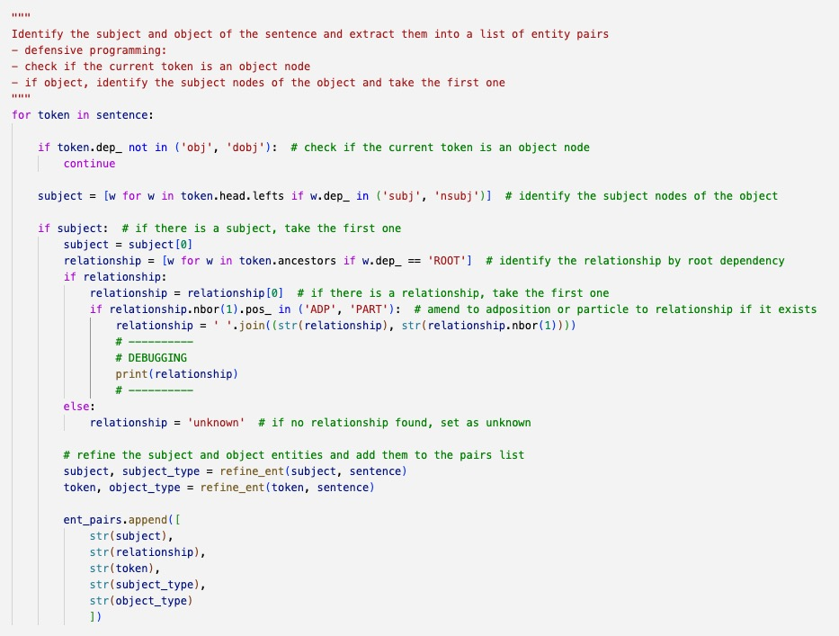
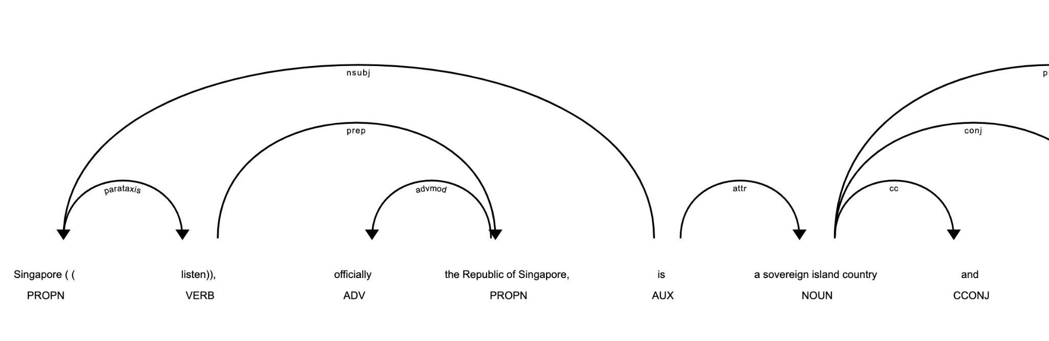
Triples & Knowledge Graphs
This was a fun learning exercise to generate triples using NER, POS tagging and merging noun chunks.
The workflow is as such:
Run co-reference resolution so each sentence is semantically rich.
Capture “real world objects” as tokens
Extract NER to identify “objects in the world”
Merge noun chunks into larger tokens (e.g. “the” + “Republic of Singapore” → “the Republic of Singapore”
Construct relationship triplets from POS tagging of tokens (in this case, we did it by sentences)
Originally implemented as custom functions. Later learned how to use pipelines to add it in easily!

Slide 22
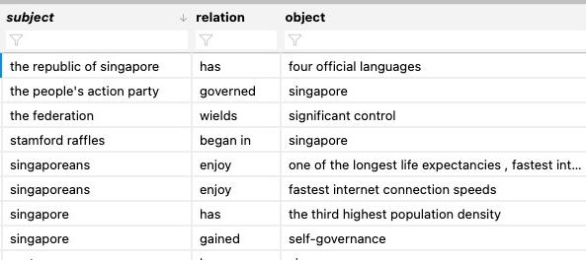
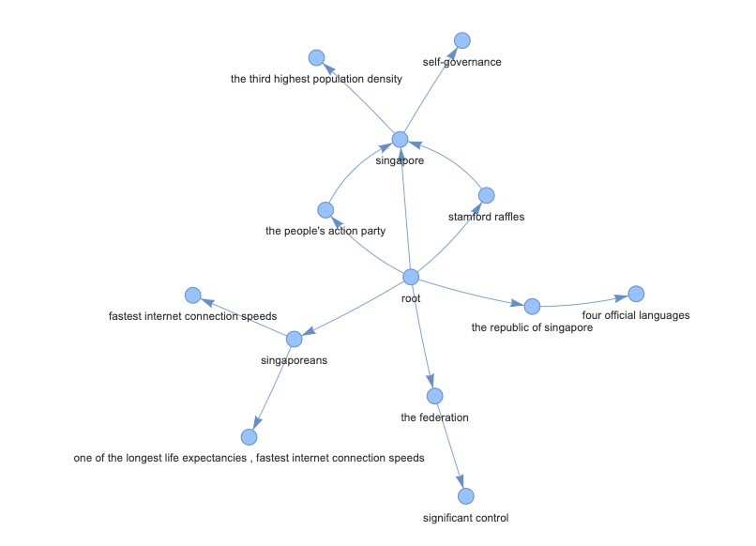
Triples & Knowledge Graphs
Sample of triple from text and interactive graph using PyVis

Slide 23
Learnings
While its nice to see progress, overall, the triples generated are still “watered down” and are unsatisfying. It needs a richer expression of the text.
NEL
named entity LINKING will perform even better at detecting “objects in the world”. This can be done via wiki-graph of DBpedia.
NEL can enrich the tokens and give us more token attributes for triple generation.
To consider more pre-processing, e.g. removing stopwords
Triple Generation -
generating triples from sentences has decent performance once co-ref res is implemented.
Reconsider the POS tags that are used for triples generation and relax the conditions.
Graph Organization - how should a graph be organized? Simply using triples
NEL Categories - Consider organizing it by NEL categories. Graph It will also allow us to extract category information about the object, which can be used to organize the graph.
Domain - considering the domain of the article we are summarizing will suggesting building “templated” graph branches that a reader would find useful. E.g. sports article → who won? What was the score?
Paragraph Summaries - paragraphs or chunks of text could be treated as 1st order nodes, from which triplets are branched off from. This provides a much richer interpretation of the text than a simple triplet list.
Text Generation from Graph - still thinking about this.
Notebook link: https://drive.google.com/drive/folders/1-2SzV0tGIrhr-eITv_SDaPCzWa7iFvcp?usp=sharing

